Slide 1
Fences Set in Pittsburgh in the 1950’s
Troy Maxson (53) —husband who works as a trash collector
Rose Maxson (43) —wife
Cory Maxson (17ish)—Troy and Rose’s teenage son
Gabriel Maxson (46)—Troy’s brother who received a head injury in WWII and is now somewhat mentally impaired
Lyons Maxson (34)—Troy’s adult son from a previous relationship
Jim Bono (50ish)—Troy’s best friend who works with him as a trash collector

Slide 2
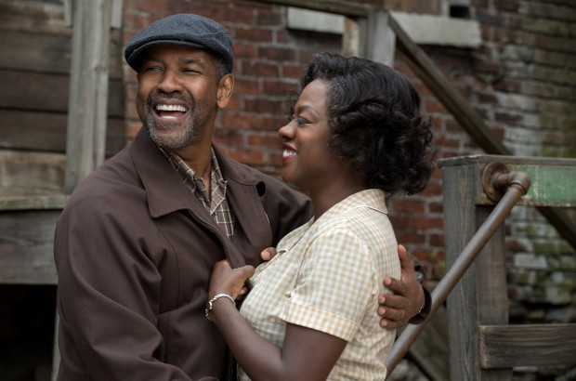
Troy and Rose Maxson
Married
Troy works as a trash
collector

Slide 3
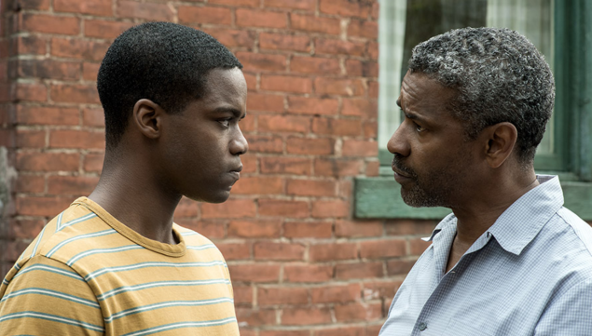
Cory Maxson
Troy and Rose’s
teenage son
Football player being
scouted by a college
team

Slide 4
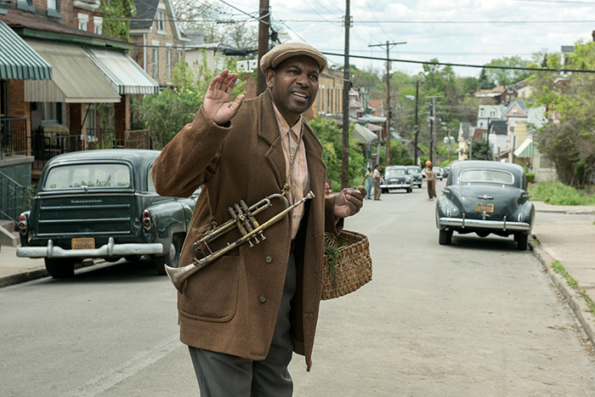
Gabriel Maxson
Troy’s brother
Sustained a head injury
in WWII that left him
mentally impaired.
As a result he behaves
eccentrically, gets in
minor trouble with the
law, develops religious
fixations.

Slide 5
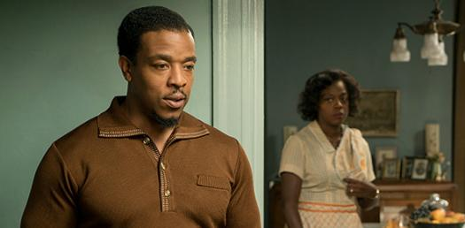
Lyons Maxson
Troy’s adult son from
a previous relationship
Trying to make a career
of being a musician
Angry at his father for
not being around during
his childhood
Comes by on Troy’s
paydays to borrow money.

Slide 6
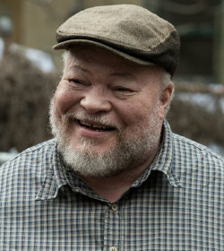
Jim Bono
Troy’s best friend who works
with him as a trash collector.

